Slide 1

Classification Project : Predict Liver Disease
Presented By Group No.4
Varsha Reddy
Hemant Shinde
Karan Patil
Omprasad Kolhal
Madhuri Varpe
junaid Pasha

Slide 2
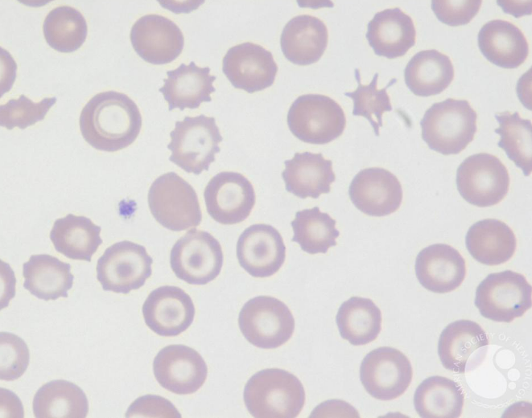
Business Objective:
The variable to be predicted is categorical (no disease, suspect disease, hepatitis c, fibrosis, cirrhosis). Therefore, this is a classification project.

Slide 3
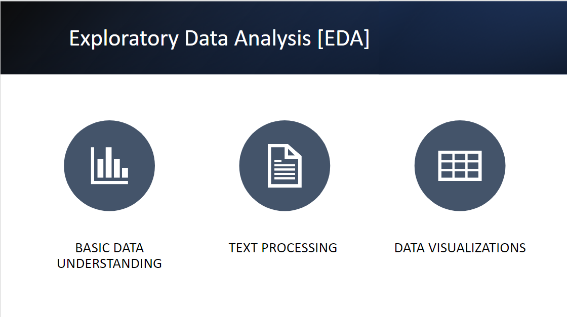

Slide 4
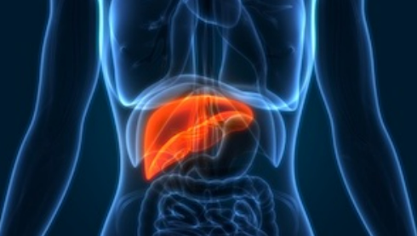
Basic Data Understanding :
The number of instances (rows) in the data set is 615, and the number of variables (columns) is 13. Nearly all input variables are numeric-valued except one, Sex, which is binary, and most of them represent measurements from blood and urine analysis.

Slide 5
Text Processing:
In a Dataset have a 615 Rows and 13 columns.
In category Column have 5 category no disease have maximum 533 entries then Cirrhosis 30, hepatitis 24, Fibrosis 21 and Suspect disease have 7 entries.
In a Data 5 columns are contain null values .
As per Domain Knowledge Null Value fill with using mean.

Slide 6
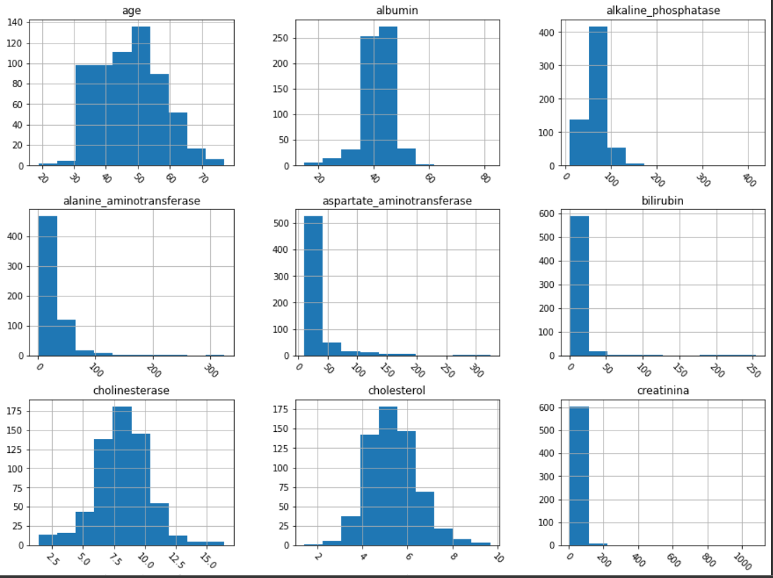
Data Visualization

Slide 7
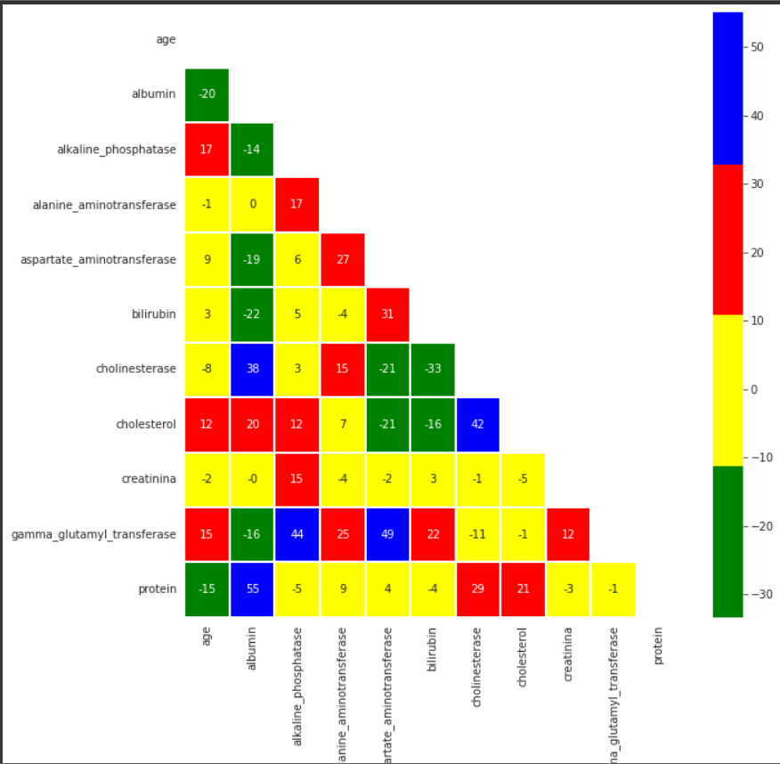
ListedColormap class is used to create colormap objects from a list of colors. This can be useful for directly indexing into colormap and it can also be used to create special colormaps for normal mapping.

Slide 8
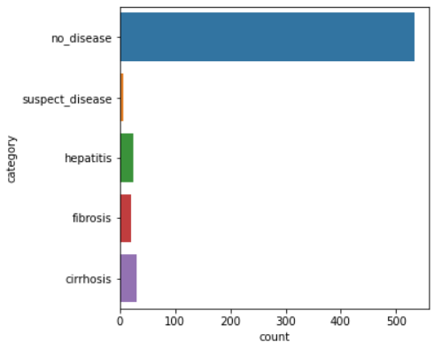
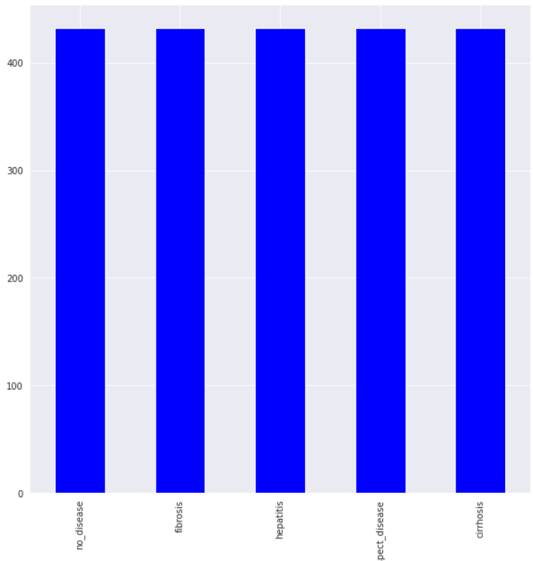
Data Balancing: A balanced dataset is a dataset where each output class (or target class) is represented by the same number of input samples.
Before Data Balancing After Data Balancing

Slide 9
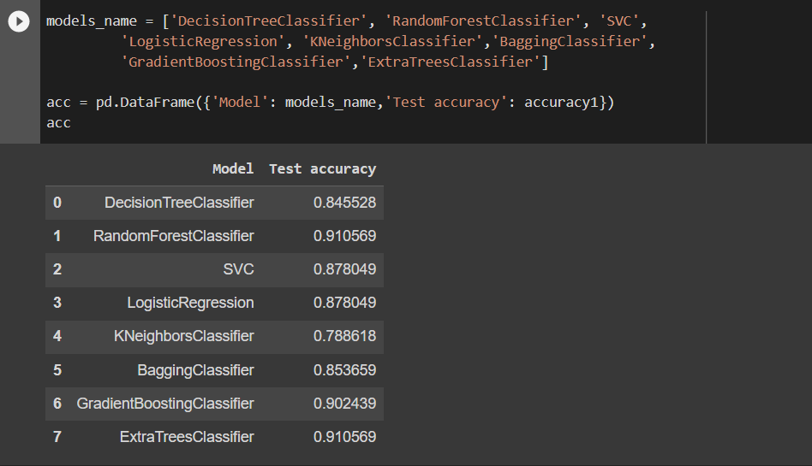
Model Building

Slide 10
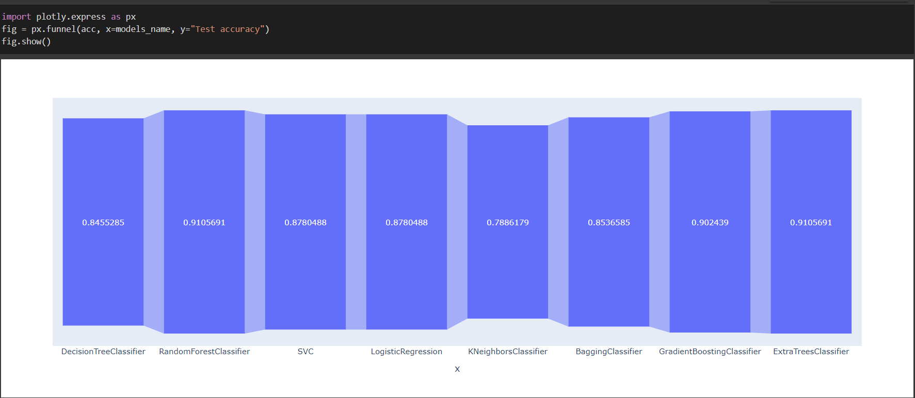
Model Accuracy Plot

